Slide 1


By
Prasad Nimse (BC258)
Pooja Ganeshkar (BC251)
Kajol Kumbhar (BC256)
Ankita Bhikule (BC249)
Under the guidance of
Ms. Swati Shekapure

Slide 2

Introduction
Problem Statement
Scope of the Project
Functional & Non-Functional Requirement
System Architecture
Algorithm
UML Diagrams
SDLC
Expected Outcome
Advantages & Disadvantages
References
Demo

Slide 3

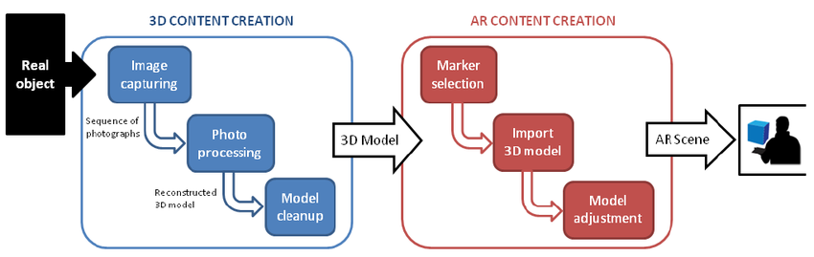
Virtual try-on applications make it possible for buyers to watch themselves wearing different watches without physically trying on them.
Within couple of seconds a virtual Watch appears above the placeholder on user phone screen.

Slide 4

In earlier days people used to try watches physically which was very time consuming but now a days by sitting at home virtual try-on systems make it possible for buyers to see themselves wearing different watches without actually wearing the watches.
Such system can improve the shopping experience by assisting customers to make purchase decisions.

Slide 5

The rapid and ever-increasing growth of online shopping is leaving traditional pattern. AR watch showed a potential where customer interact with or see how it might fit them.
Scope of this project can be extended further Like Amazon or another web application .
Apart from watch we can build that application for multiple accessories which will get displayed into the 3d form.

Slide 6

Sr. No | Paper Title and year | References | Points
1 | TDTOS – T-shirt Design and Try-On System(2015) | Chen-Yu Hsu* , Chi-Hsien Yen* , Wei-Chiu Ma* , and Shao-Yi Chien Department of Electrical Engineering, National Taiwan University | Image Retrieving Memory Control
2 | Advertisement Using Augmented Reality(4 April 2018) | S.Sivasubramaniam1 ,V.Muthu Dinesh2 , Mrs.R.Ramya3 1,2,3 Computer Science and Engineering, Kamaraj College of Engineering and Technology,Tamil Nadu, India | Composite 3D object with target image
3 | Privacy Preserving Cloth Try-On Using Mobile Augmented Reality(2018) | Yoones A. Sekhavat, Assistant Professor in Faculty of Multimedia in Tabriz Islamic Art University | Model Selection and AR Rendering
4 | Virtual Mirror Real Time Tracking of Shoes in Augmented Reality Environments(2007) | Peter Eisert, Jurgen Rurainsky, Philipp Fechteler ¨ Fraunhofer Institute for Telecommunications, Heinrich-Hertz Institute Einsteinufer 37, D-10587 Berlin, Germany | Augmentation

Slide 7

Functional Requirements | Non-Functional Requirements
Possible for buyers to wear different watches without physically trying on them. Display watches in very interactive way. | Performance Usability Reliability Availability

Slide 8

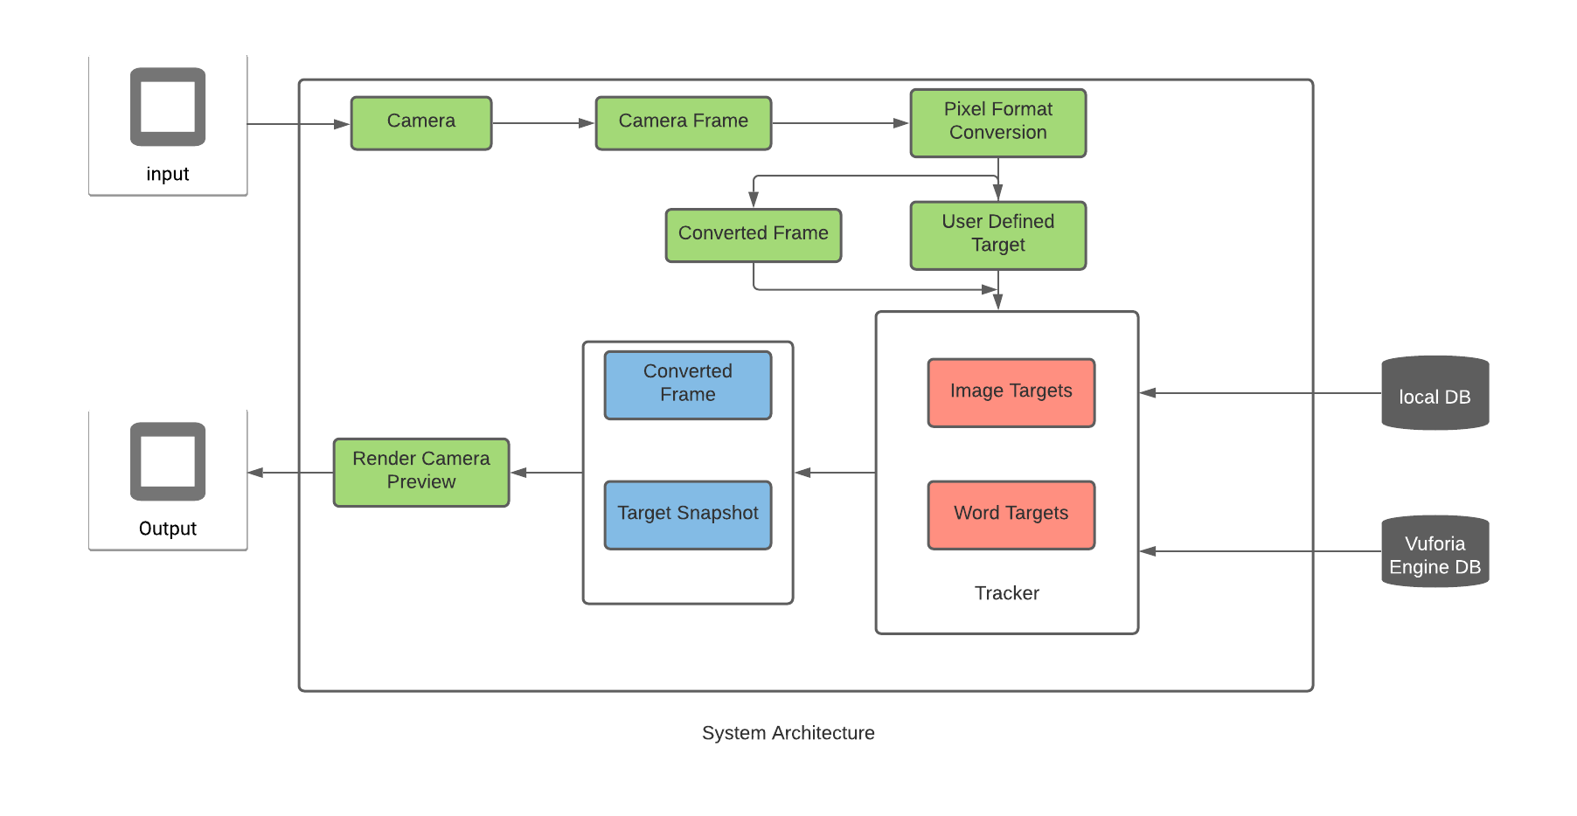

Slide 9

1.Start.
2.Launch phone camera.
3.Perform an image Recognition.
4.Make a filter to reduce the noise an AR Model.
5. working with Camera
6. Augment 3D object in target place

Slide 10
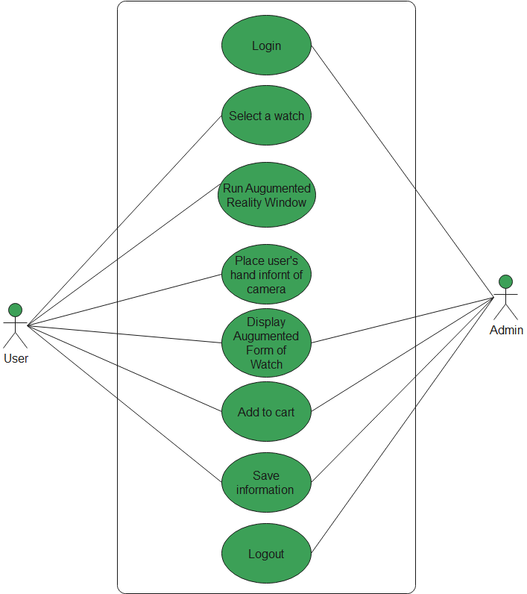

Slide 11

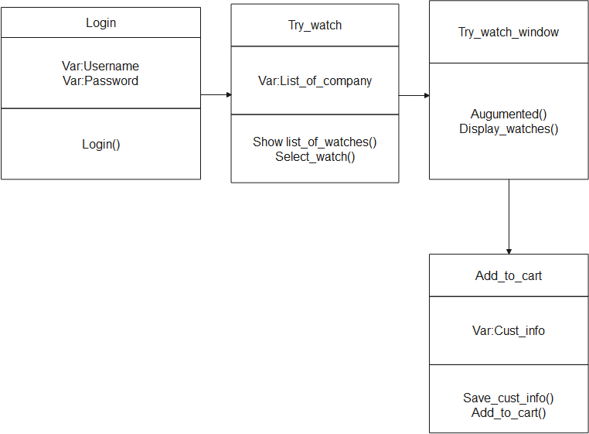

Slide 12

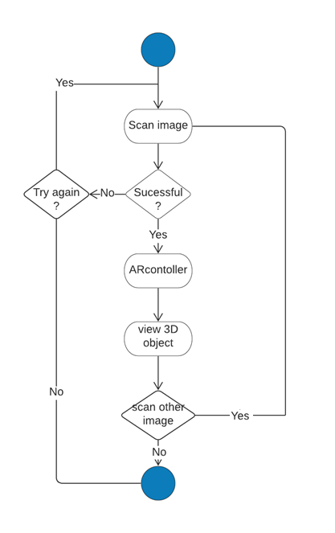

Slide 13
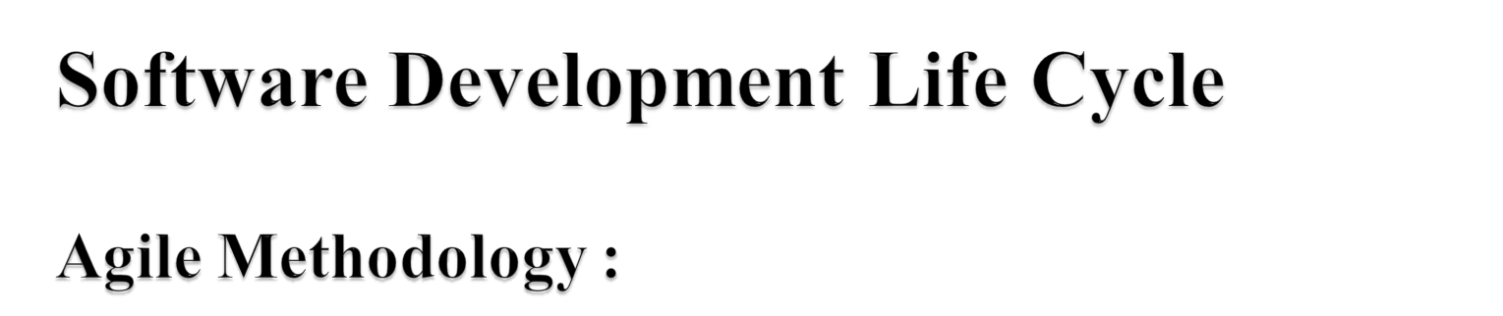
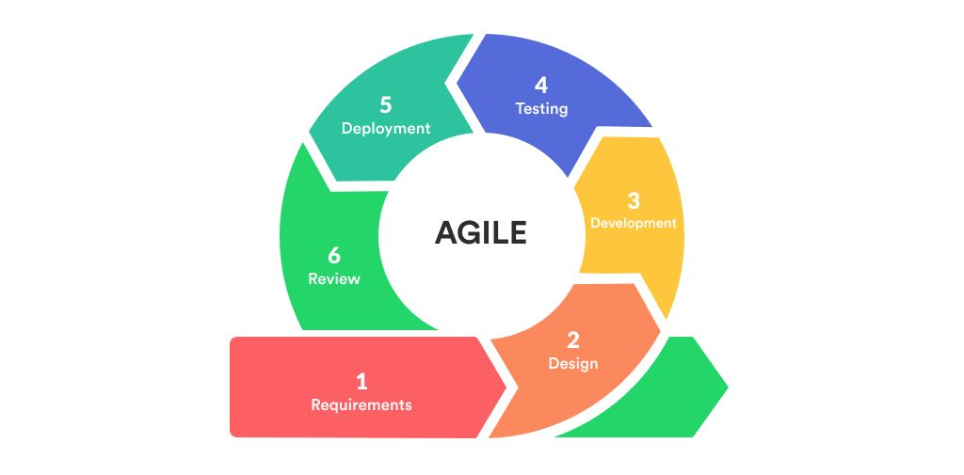

Slide 14

Application provides solutions for customer who has difficulty in visualizing the anatomy of a two-dimensional watches into a three-dimensional practice form.
System will improve the shopping experience by assisting customers to make purchase decisions.

Slide 15

Advantages | Disadvantages
Increase user knowledge and information. Ability to share experience with other people in real time over long distances. | Might be less accessible for small business. Regarding user experience socially using Augmented Reality may be inappropriate in some situations.

Slide 16

Chia-Chen Kuo National Center for High-performance Computing Hsinchu, Taiwan
S.Sivasubramaniam1 , V.Muthu Dinesh2 , Mrs.R.Ramya3 1,2,3 Computer Science and Engineering, Kamaraj College of Engineering and Technology , Tamil Nadu, India
Fraunhofer Institute for Telecommunications, Heinrich-Hertz Institute Einsteinufer 37, D-10587 Berlin, Germany.
Yoones A. Sekhavat, Assistant Professor in Faculty of Multimedia in Tabriz Islamic Art University

Slide 17

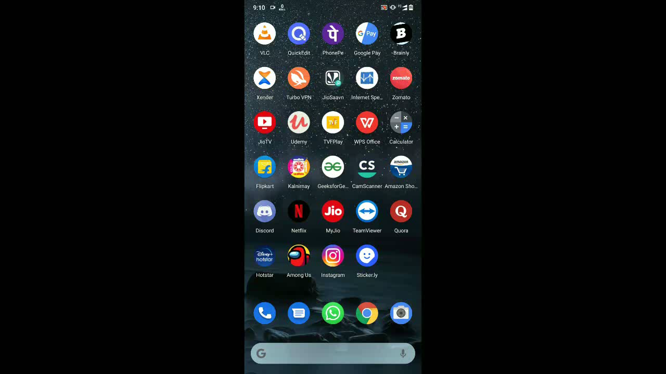

Slide 18
